Slide 1

Graph Representations: Adjacency Matrices & Adjacency List
Data Structure | Graph
Course: Data Structure | Chapter: Graph | Program: Bachelor of Engineering | Institution: Chandigarh University
DISCOVER · LEARN · EMPOWER
Notes:
Welcome students to today's lecture on Graph Representations. We will focus specifically on how to store graph data efficiently using two primary methods. This foundational knowledge is crucial for implementing algorithms like DFS and BFS later in the course. Remember, the choice of representation directly impacts the performance of your graph algorithms.

Slide 2
Course Outcomes
SLIDE 2 / 14
Course Outcome
CO | BT LEVEL | DESCRIPTION
CO1 | BT1 | Understand and apply basic data structures, algorithms, complexity analysis, ADTs, arrays and linked lists.
CO2 | BT2 | Apply and implement stacks and queues in problem-solving.
CO3 | BT3 | Analyse and apply searching, sorting, and hashing techniques.
CO4 | BT4 | Construct and apply tree structures and traversal techniques.
CO5 | BT5 | Represent and solve graph problems using DFS, BFS, and graph algorithms.
Chandigarh University
2 / 14
Notes:
Today's lecture directly addresses two specific Course Outcomes. First, we apply basic data structures like arrays and linked lists to represent graphs. Second, we learn how to represent graph problems effectively to enable algorithms like DFS and BFS. Mastering these representations is the prerequisite for solving complex graph problems efficiently.

Slide 3
Learning Objectives
SLIDE 3 / 14
Learning Outcomes
1
Define the concept of graph representation in computer science.
2
Construct an adjacency matrix for a given undirected graph.
3
Construct an adjacency list for a given directed graph.
4
Compare the space and time complexity of both methods.
5
Identify common pitfalls when implementing graph storage structures.
Chandigarh University
3 / 14
Notes:
By the end of this session, you will be able to define graph representations clearly. You will construct both adjacency matrices and lists from scratch for sample graphs. We will also compare their complexities to understand when to use which. Finally, we will discuss common mistakes students make when implementing these structures.

Slide 4
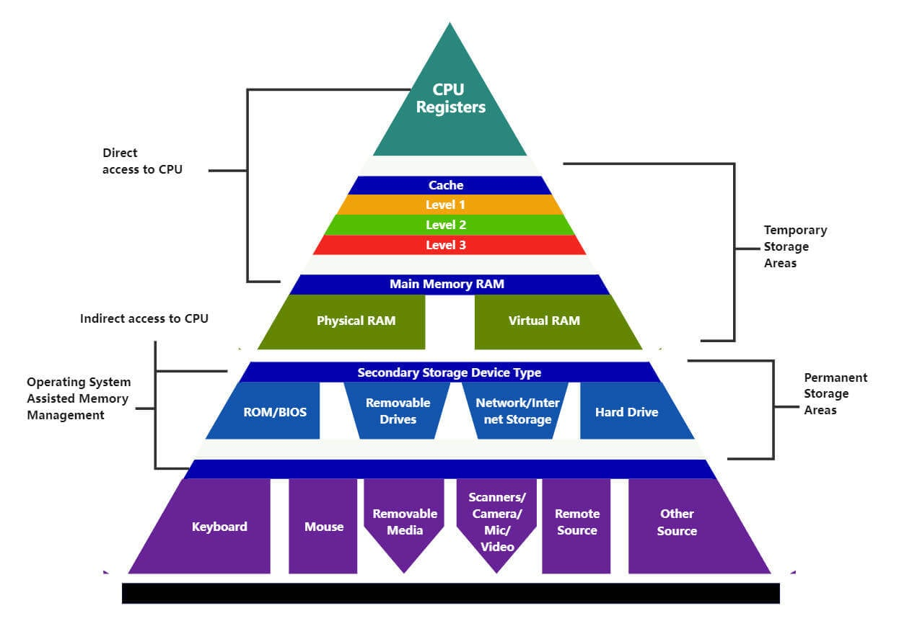
Lecture
SLIDE 4 / 14
What is Graph Representation?
TWO STANDARD METHODS EXIST
Adjacency Matrix and Adjacency List.
• A graph consists of vertices and edges that must be stored in memory.
• The representation determines how efficiently we can traverse or modify the graph.
• The choice depends on the graph density and specific algorithm requirements.
• Poor representation choices can lead to excessive memory usage or slow execution.
• We must map abstract graph concepts to concrete data structures like arrays.
Block Diagram of a CPU: Detailed Analysis of All Components
Chandigarh University
4 / 14
Notes:
Think of a graph as a map of cities and roads. We need a way to store this map in our computer's memory. The representation is the bridge between the abstract concept and the actual code. If we choose the wrong storage method, our program might run out of memory or take too long to find a path.

Slide 5
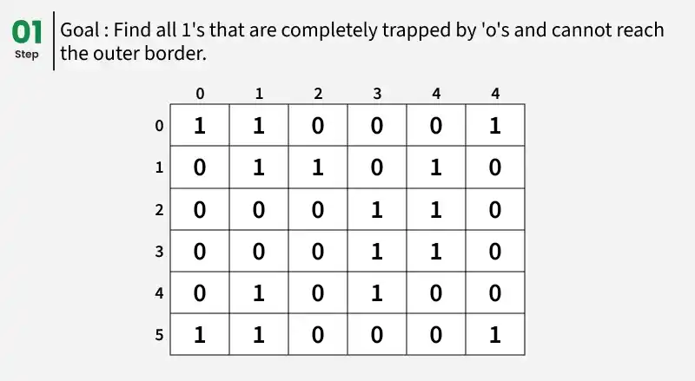
Lecture
SLIDE 5 / 14
Adjacency Matrix Definition
1
An adjacency matrix is a 2D array of size V × V where V is vertices.
2
The cell at row i and column j stores the weight or existence of an edge.
3
A value of 1 indicates an edge exists between vertex i and vertex j.
4
A value of 0 indicates no direct edge exists between the two vertices.
5
For weighted graphs, the cell stores the specific weight of the edge instead.
6
This structure provides a direct lookup for any pair of vertices in constant time.
Source: media.geeksforgeeks.org
Chandigarh University
5 / 14
Notes:
Imagine a grid where rows and columns both represent the vertices of your graph. If there is a connection between vertex 1 and vertex 3, we place a 1 at row 1, column 3. This allows us to instantly check if two nodes are connected without searching through a list. It is like a complete checklist of all possible connections.

Slide 6
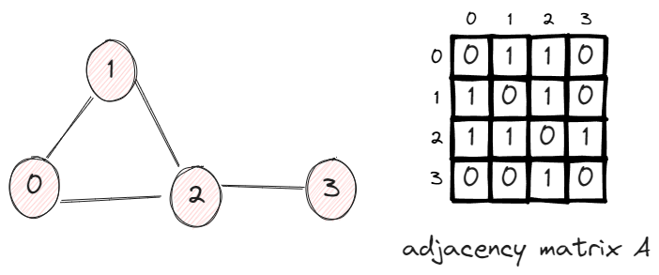
Lecture
SLIDE 6 / 14
Adjacency Matrix Example
1
Consider a graph with 4 vertices labeled 0, 1, 2, and 3.
2
Edges exist between (0,1), (1,2), and (2,3) forming a simple line.
3
The matrix will have 1s at positions (0,1), (1,0), (1,2), (2,1), etc.
4
All other cells remain 0 because no direct connection exists for those pairs.
5
For an undirected graph, the matrix is always symmetric across the diagonal.
6
The diagonal elements are always 0 unless self-loops are explicitly present.
Source: datafireball.com
Chandigarh University
6 / 14
Notes:
Let's build a matrix for a line graph: 0 connects to 1, 1 to 2, and 2 to 3. In our matrix, we place a 1 at row 0, column 1 and row 1, column 0. Since the graph is undirected, the matrix is symmetric. If you look at row 0, you see a 1 only in column 1, meaning 0 only connects to 1. This visual pattern helps verify your matrix construction.

Slide 7
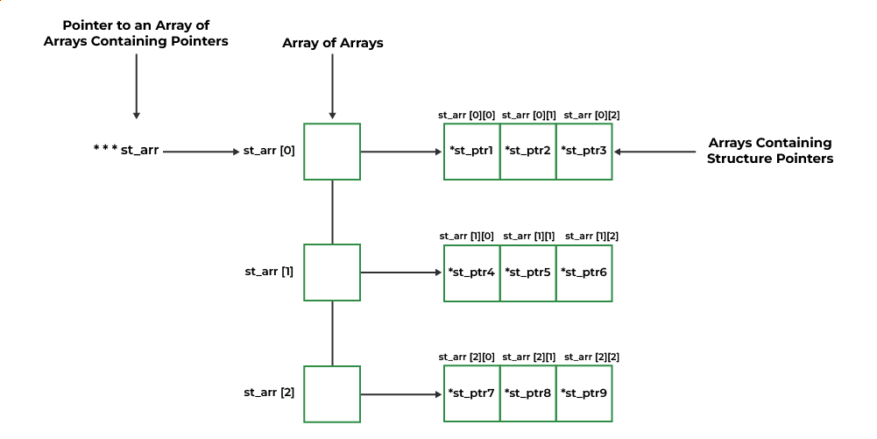
Lecture
SLIDE 7 / 14
Adjacency List Definition
1
An adjacency list uses an array of linked lists to store graph data.
2
Each index in the array represents a specific vertex in the graph.
3
The linked list at each index contains all neighbors connected to that vertex.
4
This structure stores only existing edges, making it sparse-friendly.
5
It is ideal for graphs with many vertices but relatively few edges.
6
Memory usage scales linearly with the number of vertices and edges.
Source: media.geeksforgeeks.org
Chandigarh University
7 / 14
Notes:
Instead of a full grid, we use an array where each slot points to a list of neighbors. If vertex 0 connects to 1 and 2, the list at index 0 will contain nodes for 1 and 2. This is like a phone book where each name has a list of contacts, rather than a grid showing every possible person. It saves space when connections are rare.

Slide 8
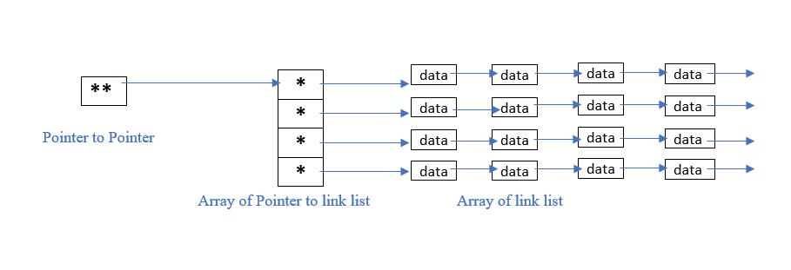
Lecture
SLIDE 8 / 14
Adjacency List Example
1
Using the same 4-vertex line graph: 0-1-2-3.
2
Index 0 contains a list with node 1.
3
Index 1 contains a list with nodes 0 and 2.
4
Index 2 contains a list with nodes 1 and 3.
5
Index 3 contains a list with node 2.
6
No empty slots exist for non-existent edges, saving significant memory.
Source: media.geeksforgeeks.org
Chandigarh University
8 / 14
Notes:
Let's visualize the list for our line graph. At index 0, we store a pointer to a list containing just 1. At index 1, we store a list containing 0 and 2. This structure clearly shows the neighbors without wasting space on zeros. If we had 1000 vertices but only 10 edges, this list would be tiny compared to a massive matrix.

Slide 9
Lecture
SLIDE 9 / 14
Space Complexity Analysis
1
Adjacency Matrix requires O(V²) space regardless of edge count.
2
Adjacency List requires O(V + E) space where E is the number of edges.
3
For dense graphs where E approaches V², the matrix is efficient.
4
For sparse graphs where E is much smaller than V², the list is superior.
5
A matrix wastes space storing zeros for non-existent connections in sparse graphs.
6
The list structure dynamically allocates memory only for actual connections.
Chandigarh University
9 / 14
Notes:
Space complexity is a critical factor in choosing a representation. A matrix always needs V squared space, so a 1000-vertex graph needs a million entries even if it has no edges. A list only needs space for the vertices plus the actual edges. If you have a sparse graph, the list saves massive amounts of memory, which is crucial for large-scale applications.

Slide 10
Lecture
SLIDE 10 / 14
Time Complexity Analysis
1
Checking if an edge exists takes O(1) time in an adjacency matrix.
2
Checking if an edge exists takes O(V) time in an adjacency list.
3
Iterating over all neighbors takes O(V) time in an adjacency matrix.
4
Iterating over all neighbors takes O(degree) time in an adjacency list.
5
Matrix operations are faster for edge queries but slower for traversal.
6
List operations are slower for queries but faster for traversing neighbors.
Chandigarh University
10 / 14
Notes:
Speed depends on what you are doing. If you need to check if two specific nodes are connected, the matrix is instant because you just look at one cell. In a list, you might have to scan the entire list of neighbors. However, if you need to visit all neighbors of a node, the list is faster because it only lists the actual neighbors, not all possible ones.

Slide 11
Lecture
SLIDE 11 / 14
Worked Numerical Example
GOVERNING EQUATION
Space for Matrix: 3² = 9 units (constant regardless of edges)
GRAPH
3 vertices (0, 1, 2) with edges (0,1), (1,2), (0,2).
MATRIX
3x3 grid with 1s at (0,1), (1,0), (1,2), (2,1), (0,2), (2,0).
LIST
Index 0 has [1, 2], Index 1 has [0, 2], Index 2 has [0, 1].
SPACE FOR LIST
3 vertices + 6 edge entries = 9 units (scales with E).
• Edge Query (0,2): Matrix takes 1 step, List takes 2 steps to find.
Chandigarh University
11 / 14
Notes:
Let's calculate the exact space for a triangle graph. The matrix needs 9 slots. The list needs 3 slots for the array plus 6 slots for the edges, totaling 9. Here they are equal. But if we add a 4th vertex with no edges, the matrix grows to 16 slots, while the list only grows to 4 slots for the array. This demonstrates how the matrix grows quadratically while the list grows linearly.

Slide 12
Lecture
SLIDE 12 / 14
Common Pitfalls & Errors
1
Forgetting to initialize the matrix with zeros before adding edges.
2
Using 1-based indexing in code when the problem uses 0-based indexing.
3
Assuming the adjacency list is sorted when it is not guaranteed.
4
Neglecting to handle self-loops in undirected graph matrix construction.
5
Confusing directed and undirected graph symmetry in matrix representation.
6
Allocating fixed-size arrays for lists without dynamic memory management.
Chandigarh University
12 / 14
Notes:
Students often make mistakes like forgetting to initialize their matrix to zero, leading to garbage values. Another common error is mixing up 0-based and 1-based indexing, which causes off-by-one errors. Always remember that adjacency lists do not guarantee sorted neighbors, so you cannot assume order. Also, ensure you handle self-loops correctly in undirected graphs.

Slide 13
Lecture
SLIDE 13 / 14
Key Takeaways
1
Adjacency Matrix uses O(V²) space and offers O(1) edge lookup.
2
Adjacency List uses O(V+E) space and offers O(degree) neighbor iteration.
3
Choose Matrix for dense graphs or frequent edge existence checks.
4
Choose List for sparse graphs or frequent neighbor traversal operations.
5
Both representations are fundamental for implementing DFS, BFS, and shortest path.
Chandigarh University
13 / 14
Notes:
To summarize, the matrix is fast for checking connections but uses more memory. The list is memory-efficient and great for traversing neighbors but slower for checking specific edges. Your choice depends on whether your graph is dense or sparse. Mastering these two structures is essential for all advanced graph algorithms you will study next.

Slide 14
Lecture
SLIDE 14 / 14
References
DATA STRUCTURES
A Pseudocode Approach with C — Gilberg, Forouzan
• Data Structures — Lipschutz
• Data Structure Using C — AK Sharma
• C and Data structure — P. S. Deshpandey
Chandigarh University
14 / 14
Notes:
For further reading, please refer to the textbooks listed on this slide. Gilberg and Forouzan provide excellent pseudocode approaches. Lipschutz offers a comprehensive theoretical background. Sharma and Deshpandey provide practical C implementations. These resources will help you deepen your understanding of graph representations and algorithms.

